Slide 1
Rendering views

Slide 2
Rendering views
A very common feature of web frameworks is the ability to render views.
The basic concept is passing your data to a template engine that will render the final view usually in HTML.
In the MVC pattern, your controller uses the model to retrieve the data portion and the view template to render the HTML output as described in the next diagram.
The Express extendable approach allows the usage of many Node.js template engines to achieve this functionality.
In this section, we'll use the EJS template engine, but you can later replace it with other template engines.

Slide 3
Rendering views (continued)
The following diagram shows the MVC pattern in rendering application views:

Slide 4
Rendering views (continued)
Express has two methods for rendering views:
app.render(), which is used to render the view and then pass the HTML to a callback function
the more common res.render(), which renders the view locally and sends the HTML as a response.
You'll use res.render() more frequently because you usually want to output the HTML as a response.
However, if, for an instance, you'd like your application to send HTML e-mails, you will probably use app.render().
Before we begin exploring the res.render() method, let's first configure our view system.

Slide 5
Configuring the view system
In order to configure the Express view system, you will need to use the EJS template engine.
Let's get back to our example and install the EJS module.
You should begin by changing your package.json file to look like the following code snippet:
{
"name": "MEAN",
"version": "0.0.3",
"dependencies": {
"express": "~4.8.8",
"morgan": "~1.3.0",
"compression": "~1.0.11",
"body-parser": "~1.8.0",
"method-override": "~2.2.0",
"ejs": "~1.0.0"
}
}

Slide 6
Configuring the view system (continued)
To configure your Express application, go back to the config/express.js file and change it to look like the following lines of code:

Slide 7
Rendering EJS views
EJS views basically consist of HTML code mixed with EJS tags.
EJS templates will reside in the app/views folder and will have the .ejs extension.
When you'll use the res.render() method, the EJS engine will look for the template in the views folder, and if it finds a complying template, it will render the HTML output.

Slide 8
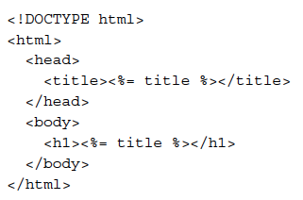
Rendering EJS views (continued)
To create your first EJS view, go to your app/views folder, and create a new file named index.ejs that contains the following HTML code snippet:
This code should be mostly familiar to you except for the <%= %> tag.
These tags are the way to tell the EJS template engine where to render the template variables—in this case, the title variable.

Slide 9
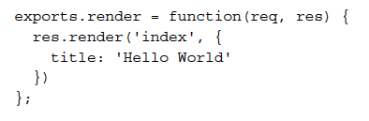
Rendering EJS views (continued)
All you have left to do is configure your controller to render this template and automatically output it as an HTML response.
To do so, go back to your app/controllers/index.server.controller.js file, and change it to look like the following code snippet:
Notice the way the res.render() method is used.
The first argument is the name of your EJS template without the .ejs extension, and the second argument is an object containing your template variables.
The res.render() method will use the EJS template engine to look for the file in the views folder that we set in the config/express.js file and will then render the view using the template variables.

Slide 10
Serving static files
In any web application, there is always a need to serve static files.
Fortunately, Express comes prebundled with the express.static() middleware, which provides this feature.

Slide 11
Serving static files (continued)
To add static file support to the previous example, just make the following changes in your config/express.js file:

Slide 12
Serving static files (continued)
The express.static() middleware takes one argument to determine the location of the static folder.
Notice how the express.static() middleware is placed below the call for the routing file.
This order matters because if it were above it, Express would first try to look for HTTP request paths in the static files folder.
This would make the response a lot slower as it would have to wait for a filesystem I/O operation.

Slide 13
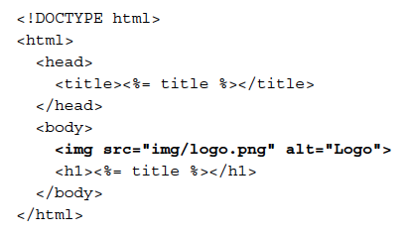
Serving static files (continued)
To test your static middleware, add an image named logo.png to the public/img folder and then make the following changes in your app/views/index.ejs file:

Slide 14
Configuring sessions

Slide 15
Configuring sessions
Sessions are a common web application pattern that allows you to keep track of the user's behavior when they visit your application.
To add this functionality, you will need to install and configure the express-session middleware.

Slide 16
Configuring sessions (continued)
To do so, start by modifying your package.json file like this:
{
"name": "MEAN",
"version": "0.0.3",
"dependencies": {
"express": "~4.8.8",
"morgan": "~1.3.0",
"compression": "~1.0.11",
"body-parser": "~1.8.0",
"method-override": "~2.2.0",
"express-session": "~1.7.6",
"ejs": "~1.0.0"
}
}

Slide 17
Configuring sessions (continued)
Once the installation process is finished, you'll be able to configure your Express application to use the express-session module.
The express-session module will use a cookie-stored, signed identifier to identify the current user.
To sign the session identifier, it will use a secret string, which will help prevent malicious session tampering.
For security reasons, it is recommended that the cookie secret be different for each environment, which means this would be an appropriate place to use our environment configuration file.

Slide 18
Configuring sessions (continued)
To do so, change the config/env/development.js file to look like the following code snippet:
module.exports = {
sessionSecret: 'developmentSessionSecret'
};

Slide 19
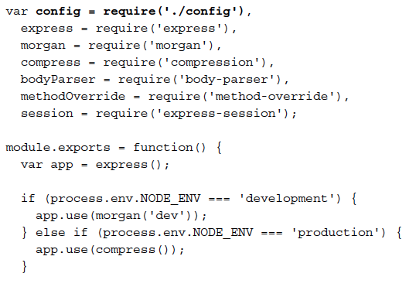
Configuring sessions (continued)
To use the configuration file and configure your Express application, go back to your config/express.js file and change it to look like the following code snippet:

Slide 20
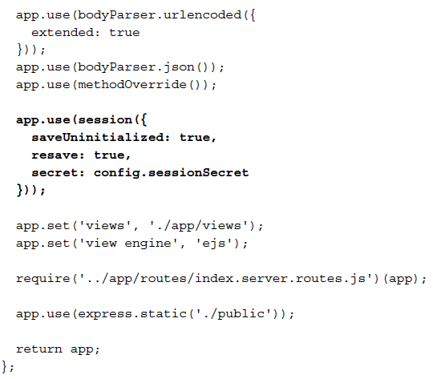
Configuring sessions (continued)
code snippet (continued):

Slide 21
Configuring sessions (continued)
Notice how the configuration object is passed to the express.session() middleware.
In this configuration object, the secret property is defined using the configuration file you previously modified.
The session middleware adds a session object to all request objects in your application.
Using this session object, you can set or get any property that you wish to use in the current session.

Slide 22
Configuring sessions (continued)
To test the session, change the app/controller/index.server.controller.js file as follows:
exports.render = function(req, res) {
if (req.session.lastVisit) {
console.log(req.session.lastVisit);
}
req.session.lastVisit = new Date();
res.render('index', {
title: 'Hello World'
});
};
What you did here is basically record the time of the last user request.
The controller checks whether the lastVisit property was set in the session object, and if so, outputs the last visit date to the console.
It then sets the lastVisit property to the current time.

